Slide 1
Van Emde Boas Tree
Analyzed Structures
Date: 27th May 2021

Slide 2




Meet the team!
Khubaib Sattar (ks05762)
Class of 2023
Haania Siddiqui (hs06188)
Class of 2023
Shamsa Hafeez
(sd06162)
Class of 2023
Iqra Siddiqui (is06176)
Class of 2023

Slide 3
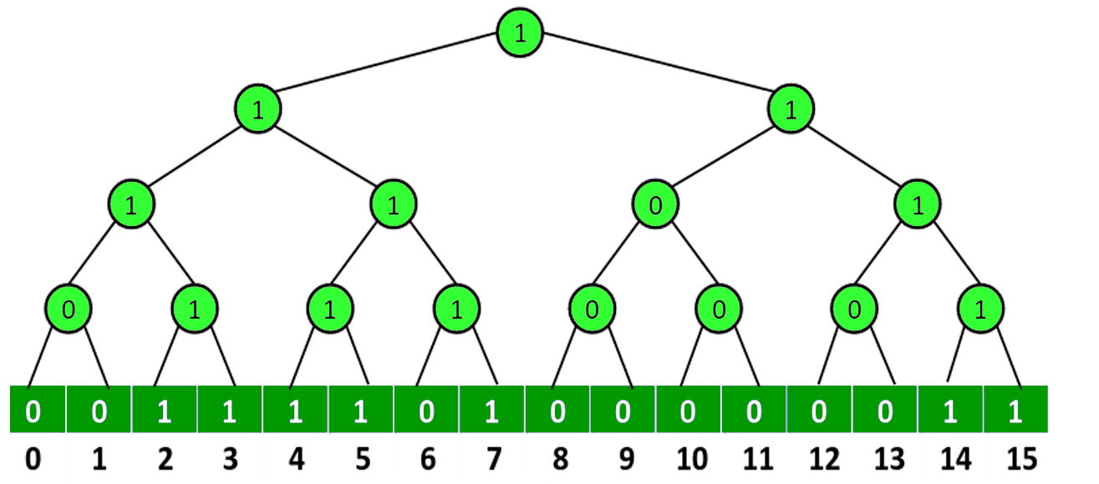

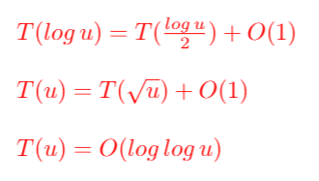
Understand The VEB Structure
u
Picture Credits: https://www.geeksforgeeks.org/proto-van-emde-boas-trees-set-1-background-introduction/
Notes:
Notice that this structure takes inspiration from a bit vector that is divided into clusters. For example …
We also store the minimum and the maximum value of each cluster
Now let us try and understand one of the very special characteristic of VEB tree i.e, its time complexity in operations like insertion, deletion and finding successor is O(log log u); where u is the size of universe
Well, what we are doing essentially is to apply a binary search on a tree of size log u. This leads us to the recurrence relation T(log u) = T(log u / 2) + O(1) . Now notice that this recurrurrence relation can be rewritten in the form T(u) = T(\sqrt(u)) + O(1) . Using a series of mathematical calculation, one can easily solve this recurrence relation and find out that the actual time complexity would be log log u which is quiet amazing

Slide 4

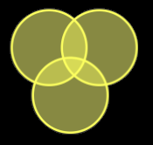
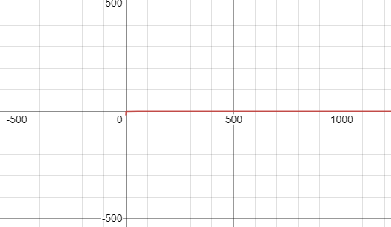
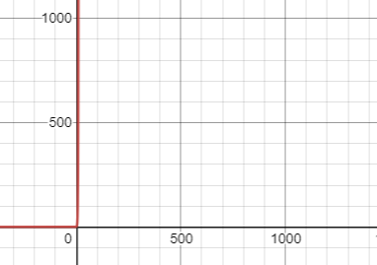

Pros
Cons
O(log log u)
$O(2^{n}$)
Graphs generated via desmos.com

Slide 5
Problem Statement
Finding Nearest Node From A Source in O(log(log u)) time complexity

Slide 6
Used Dijkstra's Algorithm
+
VEB Tree
+
Min Heap
O(u log (log u))
O(m log n)
Picture Credits: https://en.wikipedia.org/wiki/Dijkstra%27s_algorithm
Notes:
M : number of edges
N: number of nodes
O(m log n)
To find the nearest node in our graph, we used the greedy method by implement Dijistra’s Algorithm,
For the sake of comparision, as a p
For VEB:
For

Slide 7

Demonstration

Slide 8

Project Link:
https://github.com/IqraSiddiqui/analyzed_structures

Slide 9
References
https://visjs.github.io/vis-network/docs/network/
https://websitesetup.org/website-coding-html-css/
https://www.geeksforgeeks.org/dijkstras-algorithm-for-adjacency-list-representation-greedy-algo-8/
https://github.com/aishwarydewangan/Dijkstra-using-van-Emde-Boas-Tree
https://www.ics.uci.edu/~eppstein/261/w18-hw6-soln.html
http://web.stanford.edu/class/archive/cs/cs166/cs166.1146/lectures/14/Small14.pdf
https://ocw.mit.edu/courses/electrical-engineering-and-computer-science/6-046j-design-and-analysis-of-algorithms-spring-2015/lecture-notes/MIT6_046JS15_lec04.pdf
https://www.youtube.com/watch?v=hmReJCupbNU
https://ocw.mit.edu/courses/electrical-engineering-and-computer-science/6-046j-design-and-analysis-of-algorithms-spring-2012/lecture-notes/MIT6_046JS12_lec15.pdf
https://www.cosc.canterbury.ac.nz/research/reports/HonsReps/1999/hons_9907.pdf
https://www.geeksforgeeks.org/dijkstras-algorithm-for-adjacency-list-representation-greedy-algo-8/#:~:text=Min%20Heap%20is%20used%20as,(LogV)%20for%20Min%20Heap.

Slide 10


